Slide 1
Learning Objectives (Tuesday Part II)
Recall anatomical, biochemical, and functional evidence showing intimate relationships between hypothalamus and pituitary.
Describe how hormones are sensed by the neurons of the hypothalamus, and the role that the blood brain barrier and transport mechanisms play.
Recall how the central nervous system can integrate with the hypothalamus and modify both hormonal secretions and executive function.
Describe the differences in how hypothalamic signals are passed to the posterior and anterior pituitary glands.
List the known hypothalamic hormones which cause release (and release-inhibition) of anterior pituitary hormones, including their acronymns.
Name two major posterior pituitary hormones, their chemical category, and succinctly describe their secretory mechanism.
Describe cellular actions of vasopressin in terms of site of actions, receptors, and cellular signals.
Discuss briefly aquaporin water channels and relation to vasopressin.
Predict what the changes are expected in urine volume and osmolality and in ECF volume when vasopressin synthesis or secretion is severely impaired. Predict what will happen to water intake. Explain why there can be transient diabetes insipidus following a whiplash injury, and the rationale for therapy during this time.
Describe the control of vasopressin release.
Describe the function of oxytocin with respect to delivery and lactation.

Slide 2
Discuss with Folks Nearby
How could whiplash cause diabetes insipidus?
HINT: Relates to damage/severing of infundibulum
Notes:
Severed pituitary stalk -> low vasopressin -> low water reabsorbtion -> diabetes insipidus

Slide 3
Quiz Question

Slide 4
Adrenal Gland and Stress Hormones

Slide 5
Learning Objectives
Name three zones in the adrenal cortex and major regulator(s) of each zone.
Name three steroidogenesis pathways and their major products.
Explain briefly the physiological mechanism of adrenogenital syndrome.
Describe the physiological actions and roles of aldosterone.
Explain briefly the renin-angiotensin system.
Describe the negative feedback regulation of aldosterone and its relationship to blood volume/blood pressure homeostasis.
Describe hepatic and extrahepatic metabolic actions of glucocorticoids. Discuss their relationship.
State the major findings caused by adrenal hypersecretion of mineralocorticoids.
State the major findings caused by adrenal hypersecretion of glucocorticoids.
Name the major hormones secreted from the adrenal medulla. Discuss the differences of epinephrine (epi) and norepinephrine (NE) in cardiovascular actions (physiological levels).
List the major metabolic actions of catecholamines.
Contrast the thresholds for actions vs. plasma levels of epi and NE under common conditions, like exercise, and in the disease pheochromocytoma

Slide 6
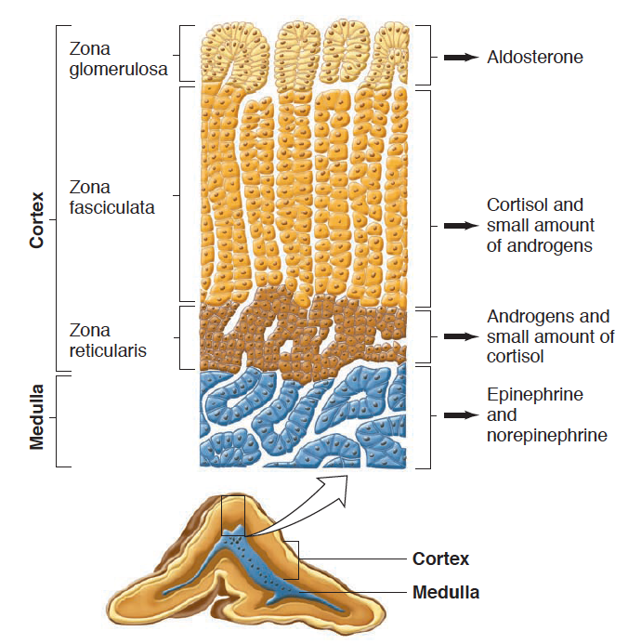
Adrenal Gland Anatomy

Slide 7
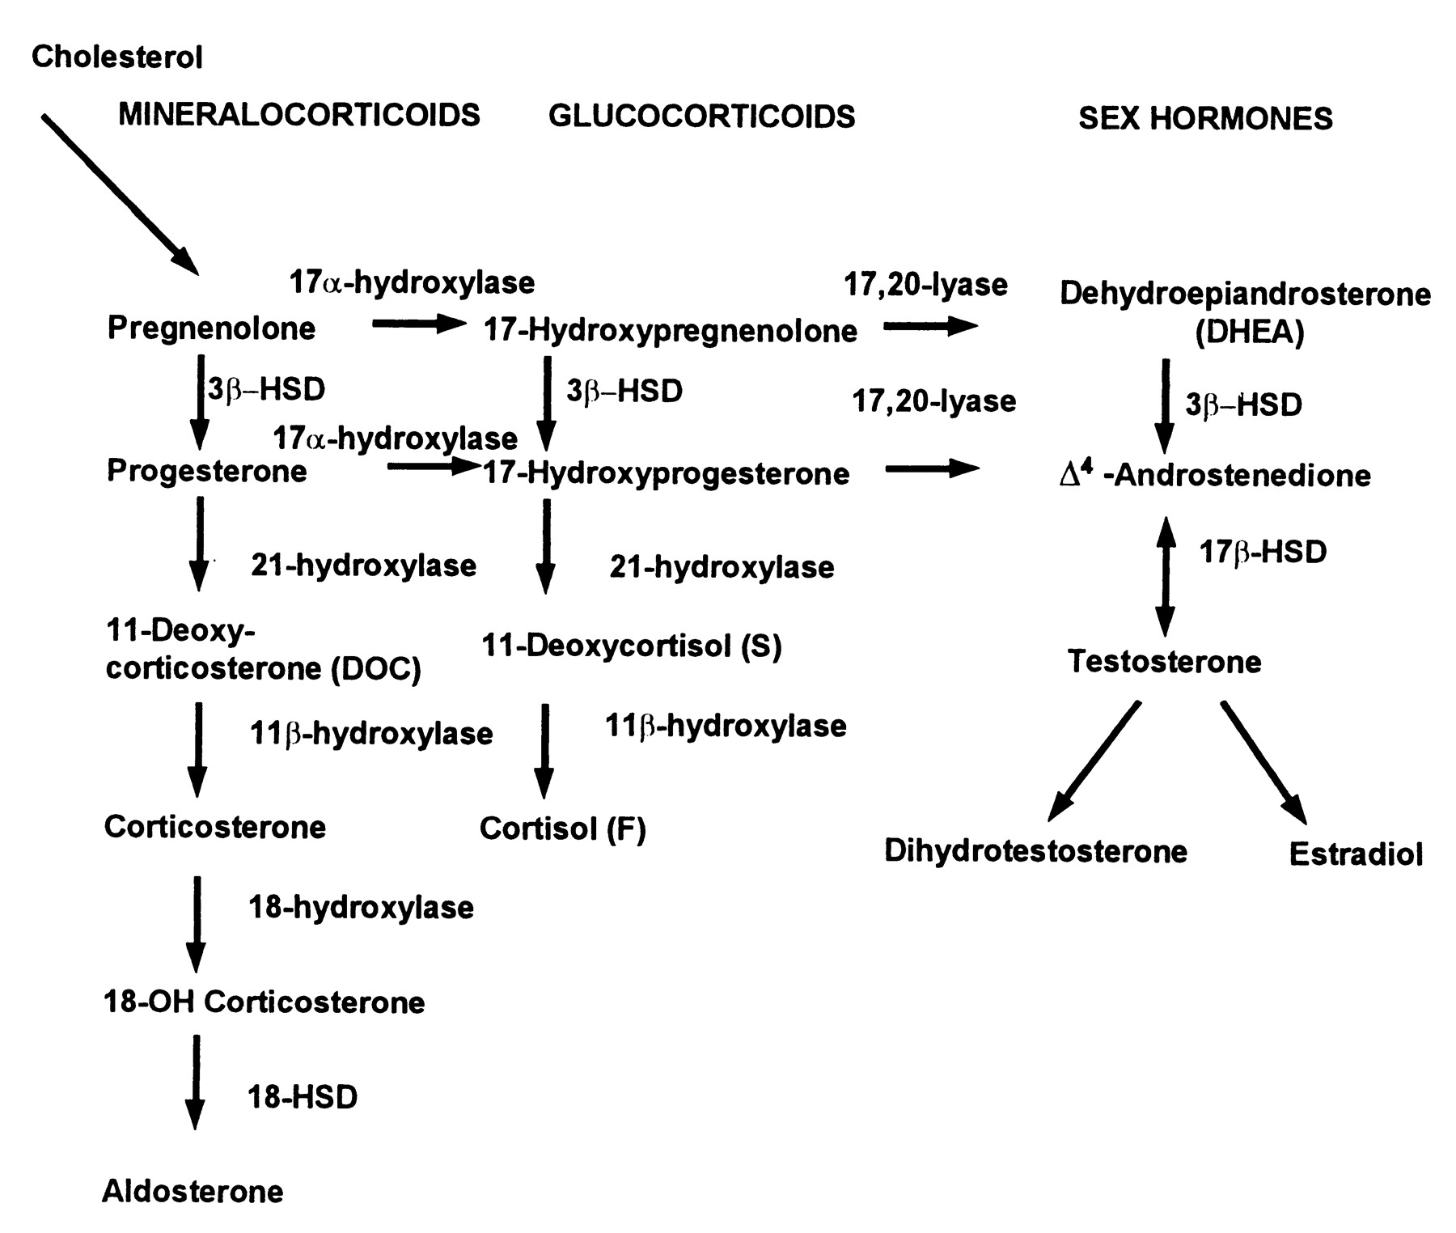
Steroid Hormone Biosynthesis
Maria I. New, and Robert C. Wilson PNAS 1999;96:12790-12797

Slide 8
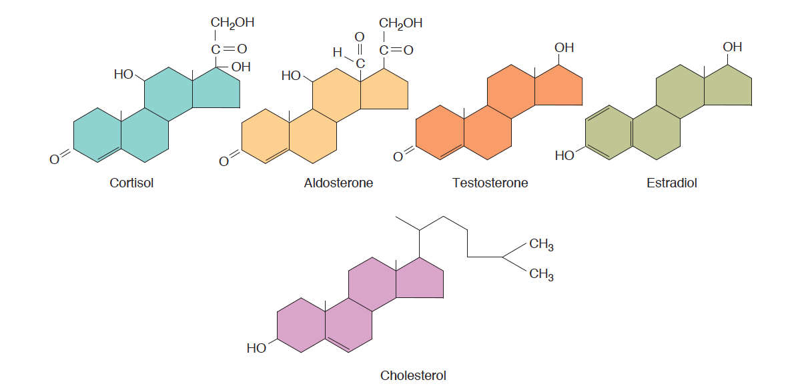
Steroid Hormones Released From Adrenal Medulla

Slide 9
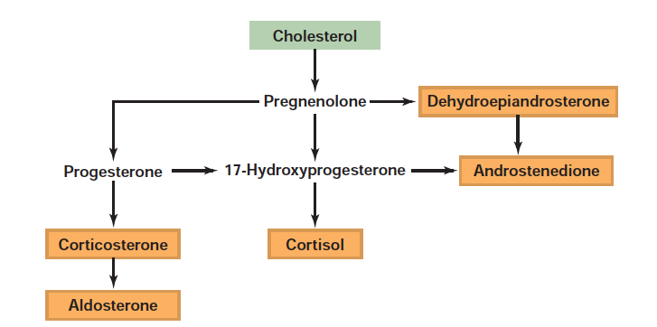
Steroid Hormone Synthesis

Slide 10
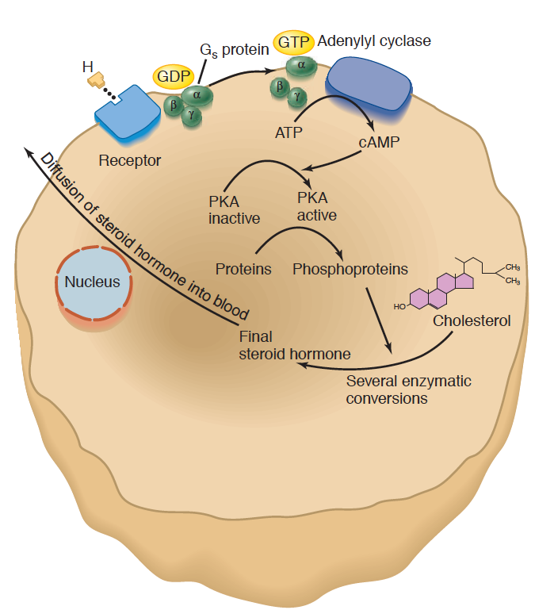
Steroid Hormone Synthesis Mechanisms
Signal | Receptor | Hormone
ACTH | MC2R (GPCR - Gs) | Cortisol
Angiotensin II | AGTR1 (GPCR – Gq) | Aldosterone

Slide 11
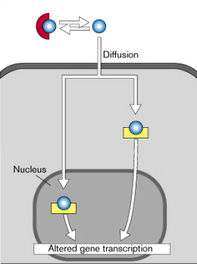
Both Aldosterone and Cortisol Function Through Nuclear Hormone Signaling

Slide 12
Aldosterone Regulates Mineral Balance

Slide 13
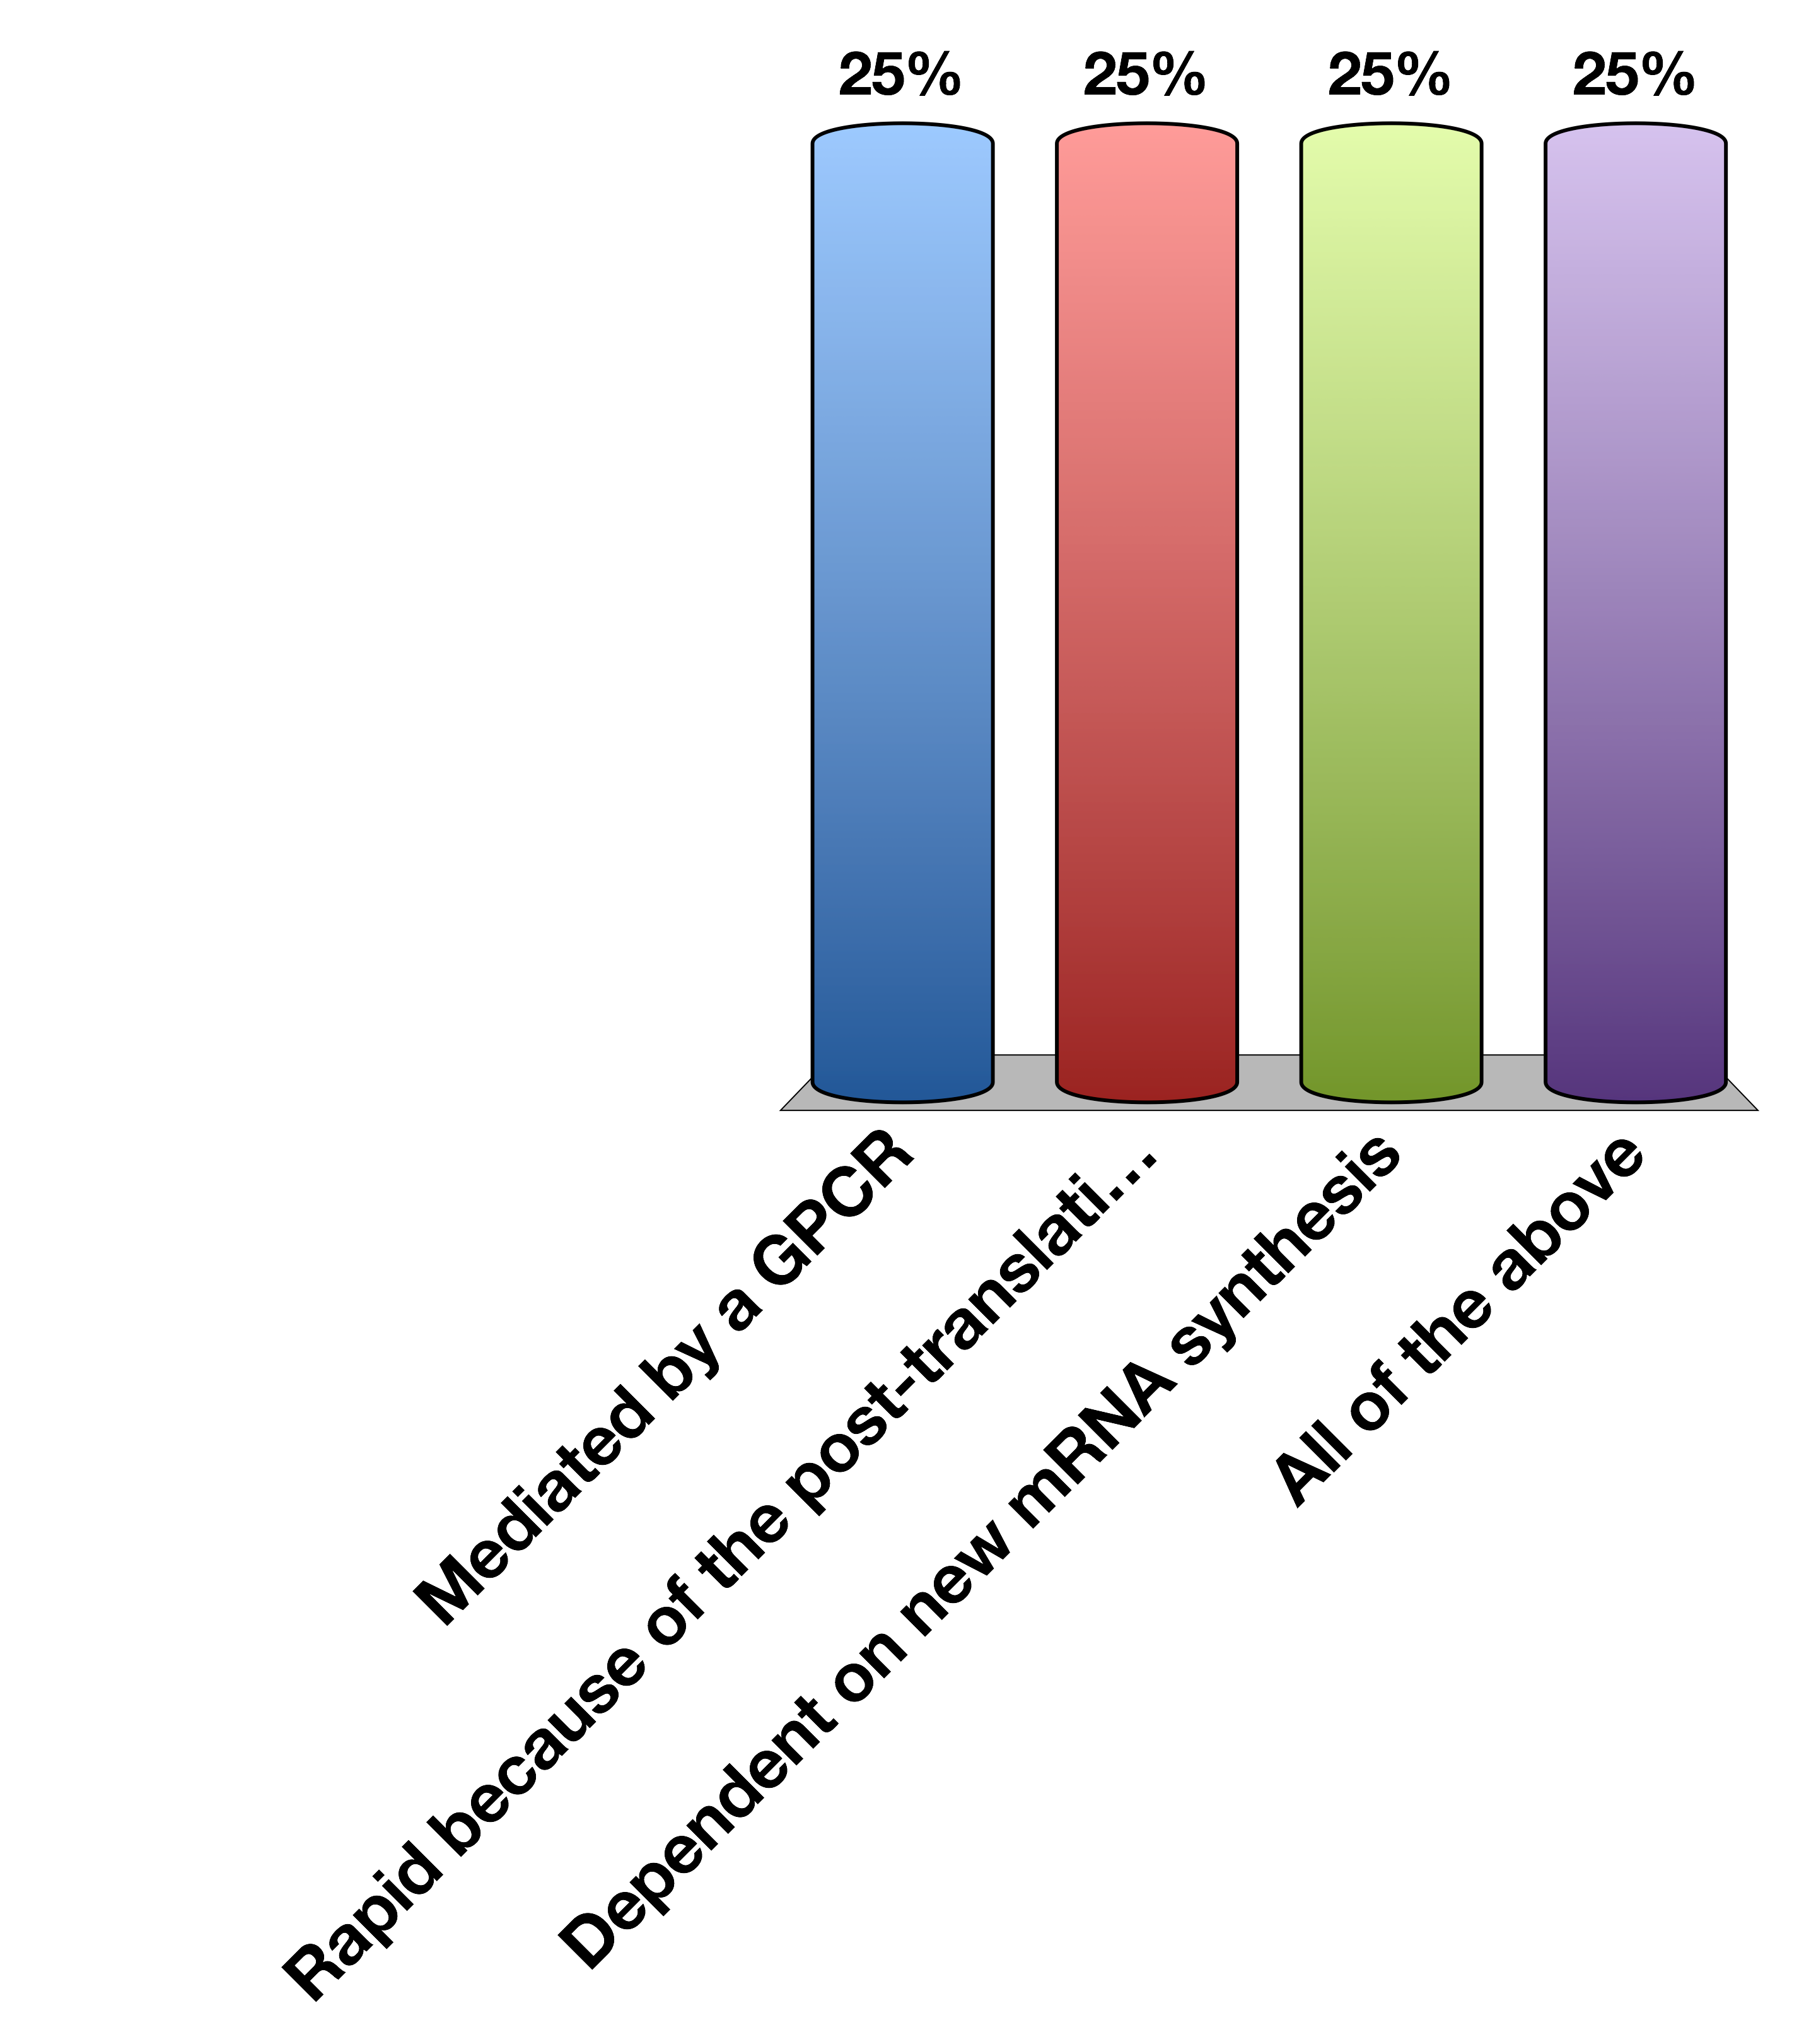
Direct Aldosterone Effects on Cells Are…
Mediated by a GPCR
Rapid because of the post-translational modification of enzymes
Dependent on new mRNA synthesis
All of the above

Slide 14
Aldosterone Summary
What chemical type | Steroid hormone
Where is it made? | Adrenal Cortex (Zona glomerulosa)
What causes its release? | Angiotensin II Signaling (GPCR –Gq) and to a lesser extent ACTH
What are its receptors? | Mineralcorticoid Receptor
What tissues does it affect? | Kidneys (Collecting Ducts and Distal Convoluted Tubule) | ENAc, Na/K Transporter/SGK
How does it get turned off? | Receptor desensitization, less ATII signaling, 11BHSD2

Slide 15
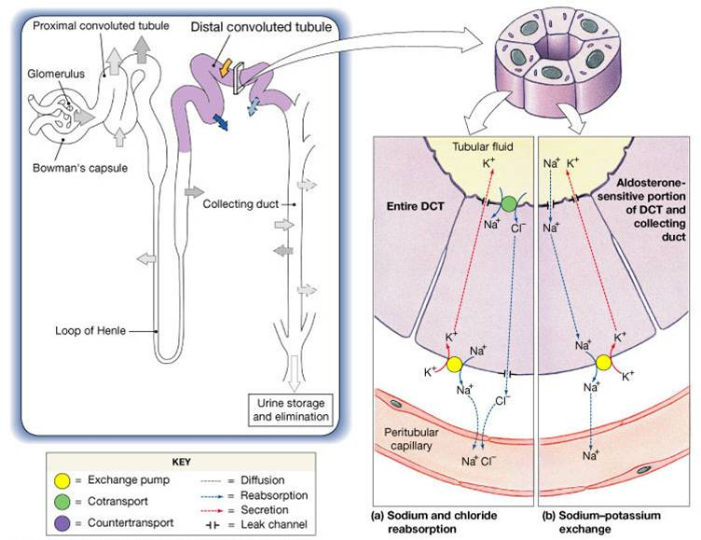
Key Aldosterone Effectors
ENac
Na/K

Slide 16
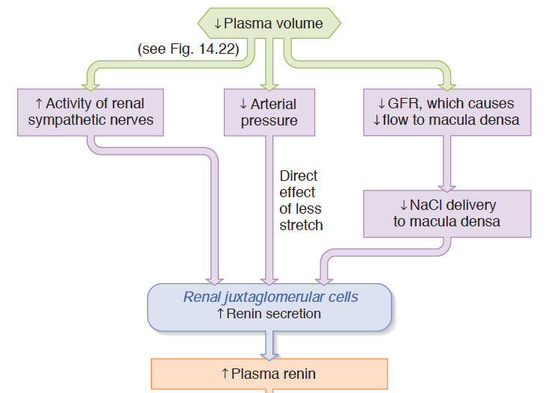
Renin as a Volume/Pressure Sensor

Slide 17
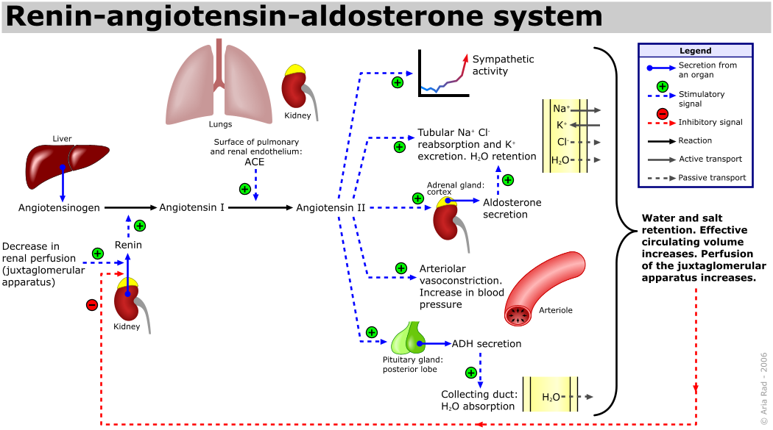
The Renin/Angiotensin System
Notes:
Point out the negative feedback occurs via sensing at the JG cell.
Less stretch, less
This is separate to just the effects of vasopressin

Slide 18
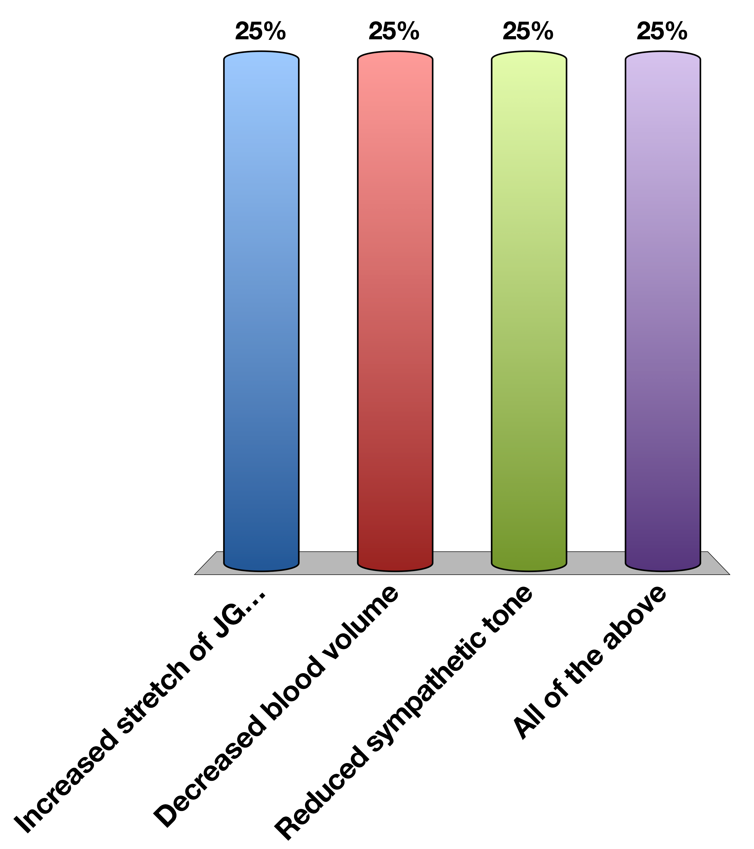
Renin Secretion is Stopped By
Increased stretch of JG cells
Decreased blood volume
Reduced sympathetic tone
All of the above
Response Counter
30

Slide 19
Stress Responsive Hormones

Slide 20

Two Types of Stress Response
Adrenaline
Cortisol

Slide 21
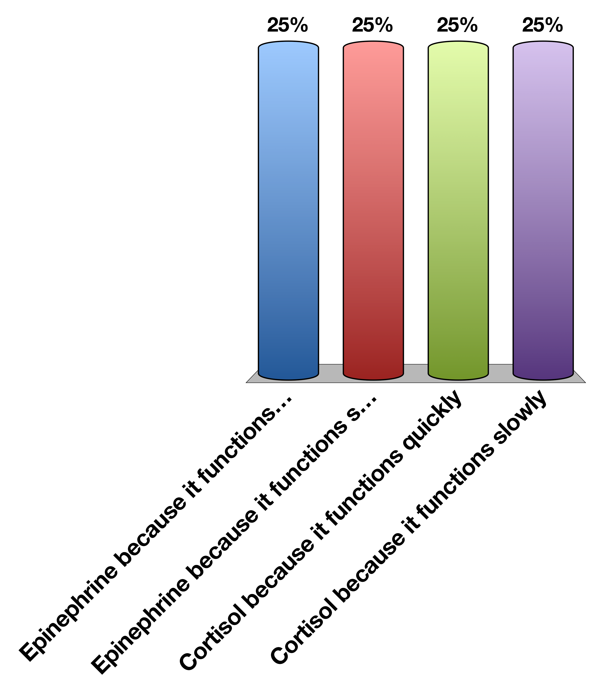
Which hormone should mediate longer lasting stress responses?
Epinephrine because it functions quickly
Epinephrine because it functions slowly
Cortisol because it functions quickly
Cortisol because it functions slowly

Slide 22
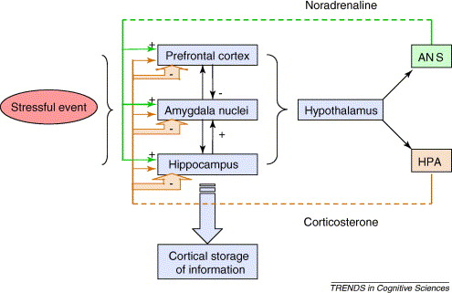
CRH Release

Slide 23

CRH is released from the hypothalamus to the anterior pituitary, so therefore…
Is trafficked via the hypophysial portal system
Is Directly secreted via neurons which pass through the infundibulum
Binds a JAK/STAT receptor
All of the above

Slide 24
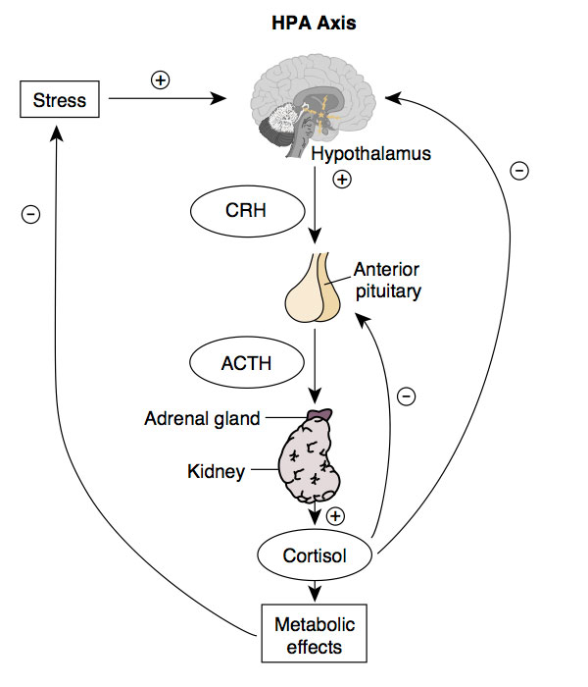
HPA Axis

Slide 25
Corticotropin Releasing Hormone
Where is it made? | Hypothalamus (PVN)
What causes its release? | Stress (Synaptic Inputs)
What are its receptors? | CRHR1/2 (Gs)
What tissues does it affect? | Corticotropes in the Anterior Pituitary | ACTH Release
How does it get turned off? | Receptor desensitization, Cortisol Negative Feedback to Hypothalamus, 11BHSD2

Slide 26
ACTH
Where is it made? | Corticotropes of the Anterior Pituitary
What causes its release? | CRH into the hypophysial portal system
What are its receptors? | ACTHR (Gs - GPCR)
What tissues does it affect? | Adrenal Cortex | Cortisol release
How does it get turned off? | Receptor desensitization, Cortisol Negative Feedback to Hypothalamus, Cortisol Negative Feedback to Hypothalamus 11BHSD2

Slide 27
Cortisol Summary
Where is it made? | Adrenal Cortex (Zona fasciculata)
What causes its release? | ACTH (GPCR –Gs)
What are its receptors? | Glucocorticoid Receptor
What tissues does it affect? | Muscle | Protein Catabolism
 | Adipose | Increased Lipolysis, Adipogenesis
 | Liver | Increased Gluconeogenesis
 | Brain | Less Food Intake
 | Immune System | Reduced Th2 Activation
How does it get turned off? | Receptor desensitization, Negative Feedback to Pituitary, Negative Feedback to Hypothalamus, 11BHSD2

Slide 28
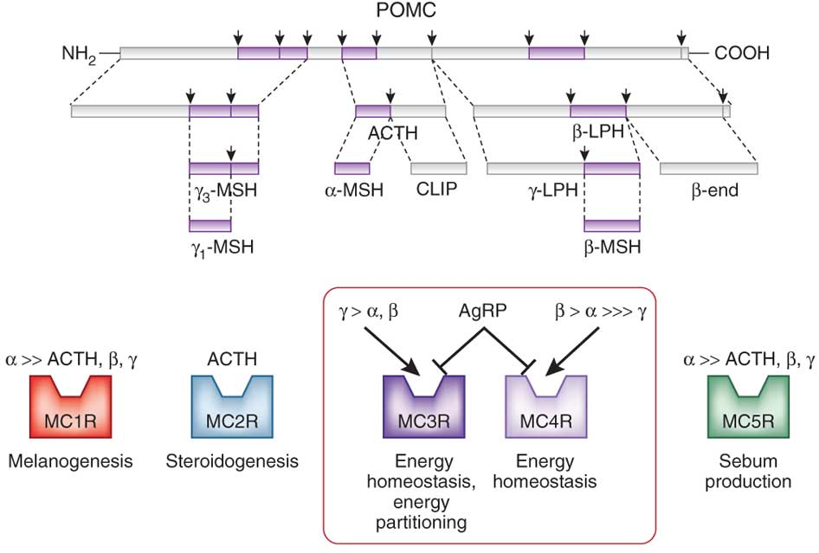
ACTH and other Hormones are Generated from POMC Transcripts

Slide 29
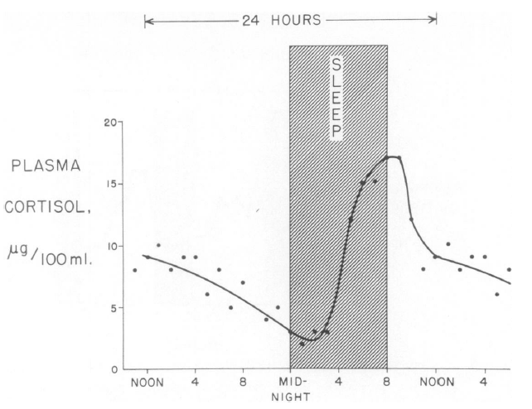
Daily Rhythms of Cortisol Release
Liddle GW (1966) An analysis of circadian rhythms in human adrenocortical secretory activity. Trans Am Clin Clim Assoc 77: 151–160.
Notes:
Related to this, prolonged fasts also elevate cortisol levels

Slide 30
Major Chronic Responses to Stress
Shift resources (mainly glucose) towards essential functions
Suppress non-essential functions
Immune system
Reproductive system
Growth

Slide 31
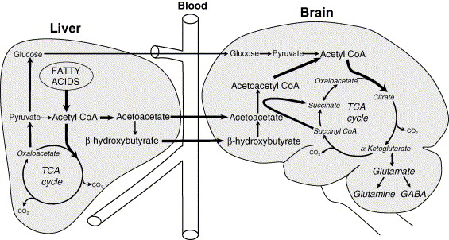
Brain Requires Glucose Supply
Notes:
Dosent store glycogen, limited gluconeogenic capacity

Slide 32
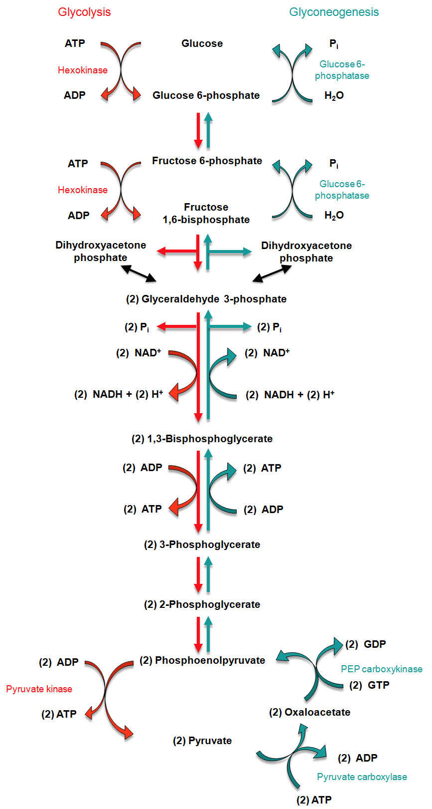
Regulation of Gluconeogenesis
Activation by glucocorticoids in the liver

Slide 33
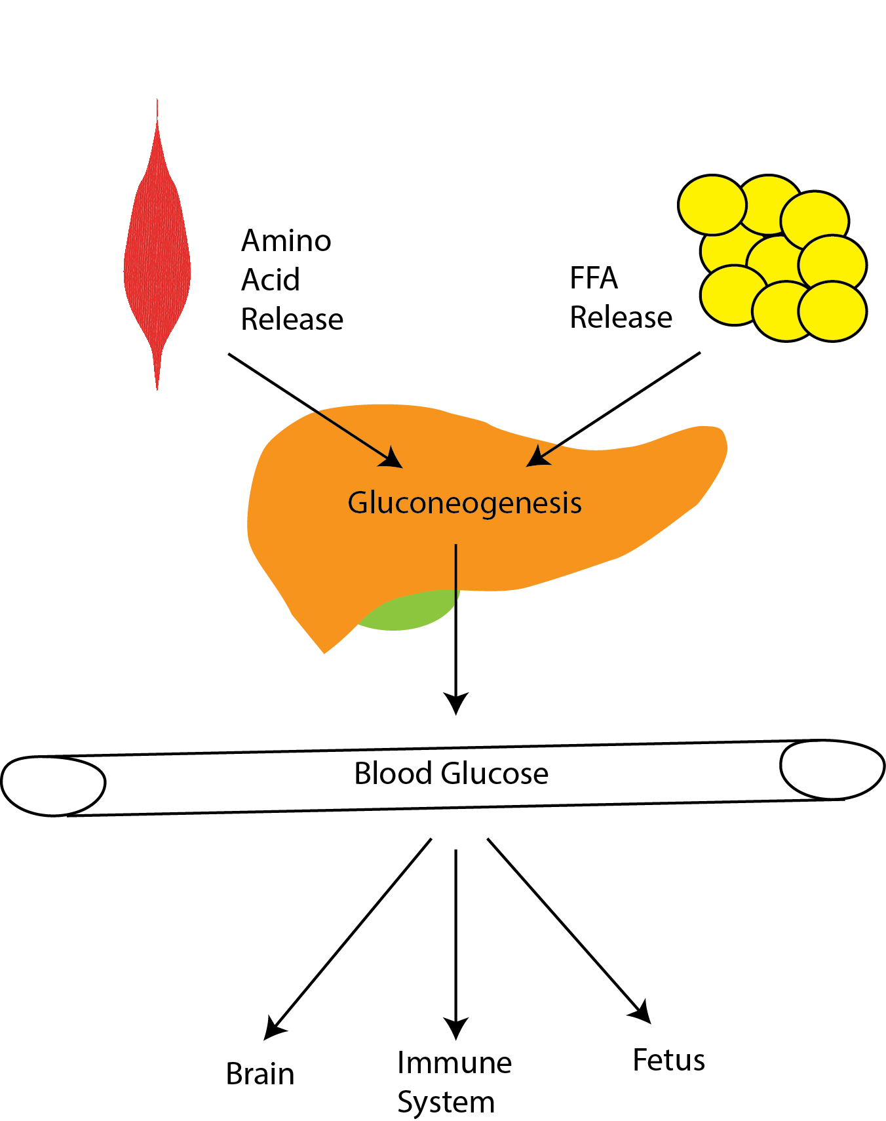
Cortisol Maintains Blood Glucose Levels
Notes:
Induces gluconeogenesis
Induces protein/triglyceride breakdown
Promotes insulin resistance

Slide 34
Three Mechanisms to Maintain Blood Glucose Levels
Promote gluconeogenesis (liver)
Provide substrates for gluconeogenesis (muscle/fat)
Prevent glucose uptake (muscle/fat)

Slide 35
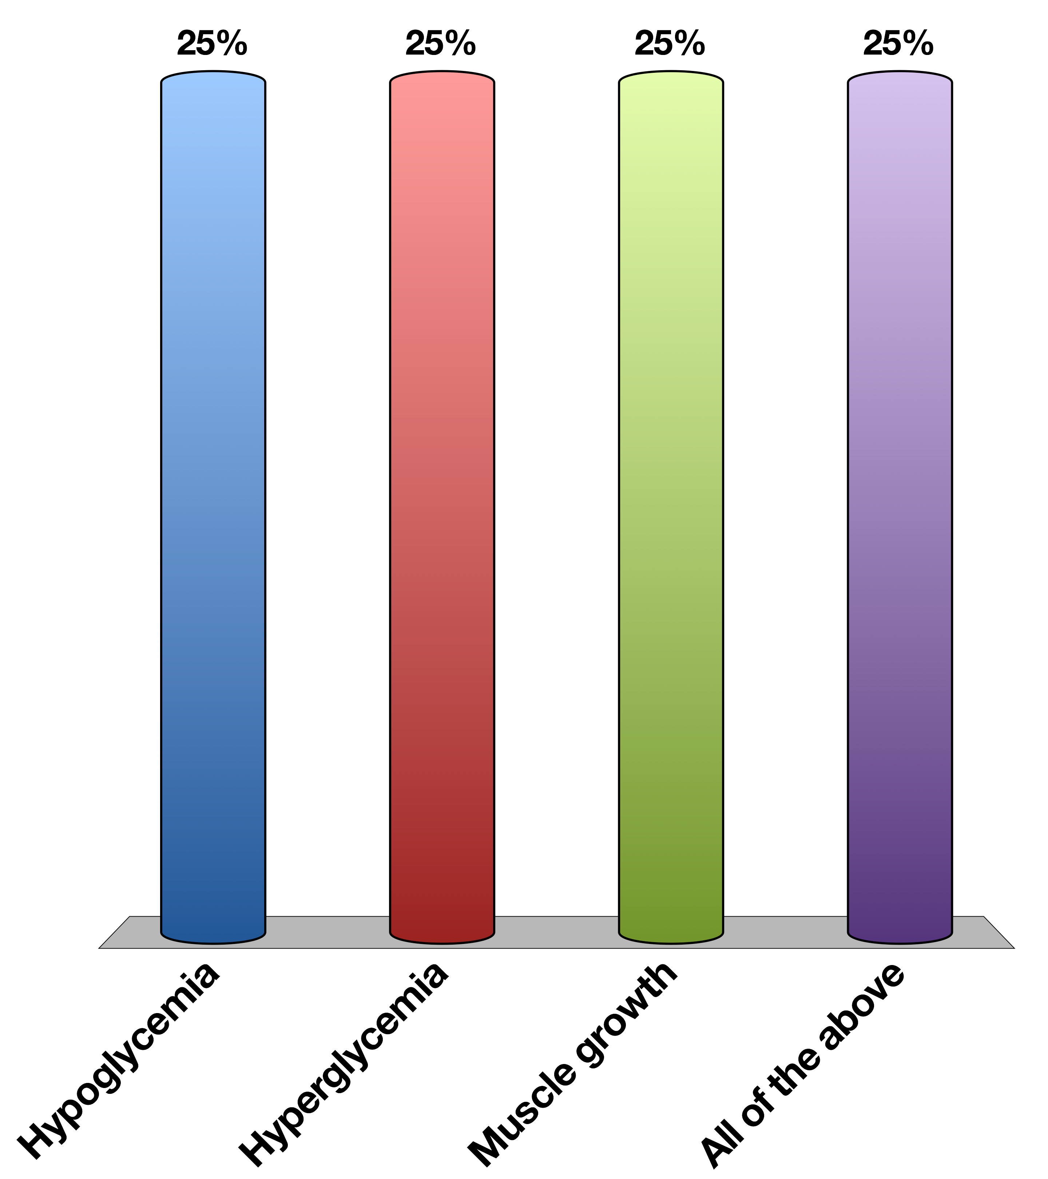
Chronically elevated glucocorticoid signaling would cause
Hypoglycemia
Hyperglycemia
Muscle growth
All of the above
Response Counter
30

Slide 36
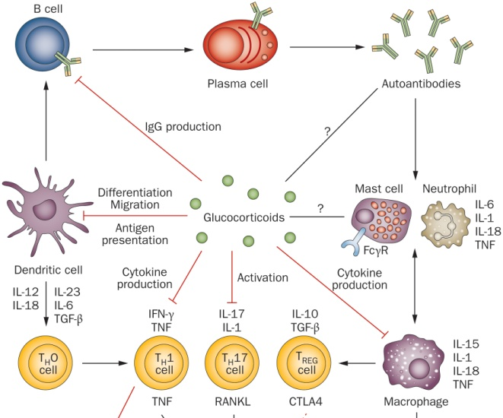
Effects of Cortisol on Immune Function

Slide 37
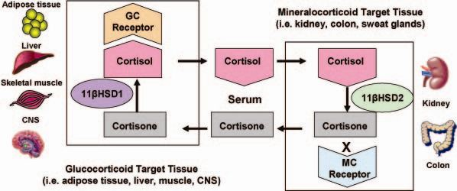
11β-HSD 2 and Local Concentrations of Glucocorticoids

Slide 38
Adrenal Steroid Hormone Disfunction

Slide 39
Common CAH Mutations
Maria I. New, and Robert C. Wilson PNAS 1999;96:12790-12797
Notes:
90% are 21-hydroxylase
Effects of CAH on sex steroids
Smaller number are

Slide 40
Discuss
Congenital Adrenal Hyperplasia (aka adrenogenital syndrome)
Mutations in genes involved in the biosynthesis of cortisol/aldosterone
What would be the effects on
Sex hormone production
Salt balance
Adrenal size

Slide 41
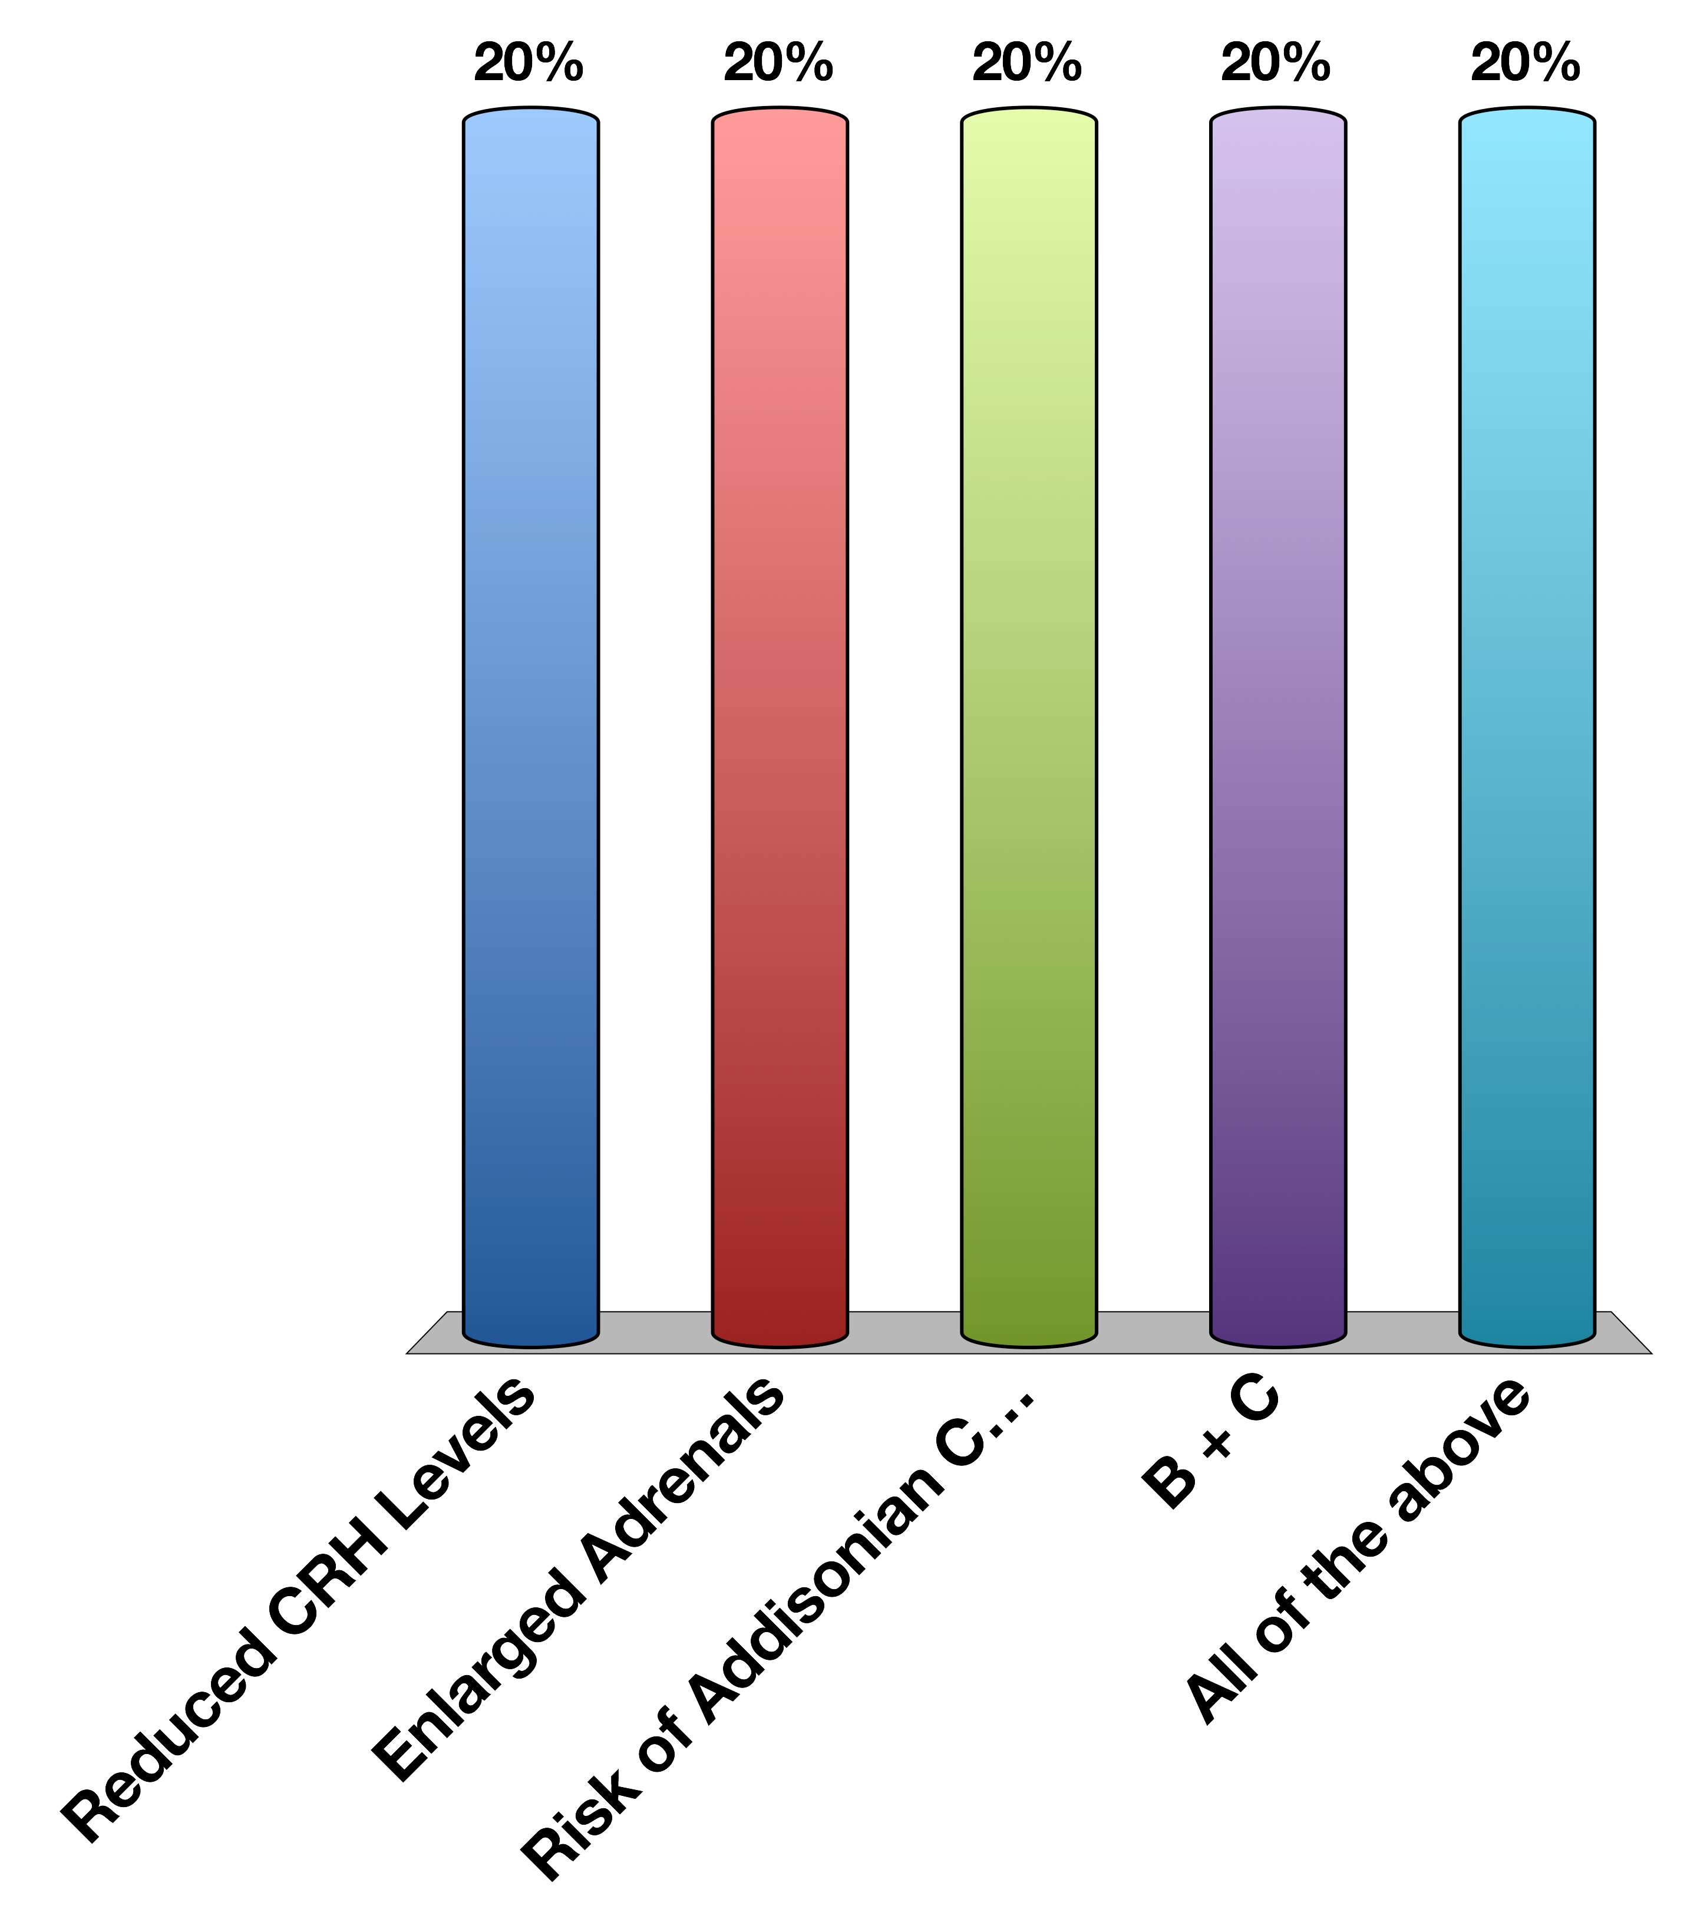
A Patient with a type of CAH that can not make Cortisol Would be Expected to have…
Reduced CRH Levels
Enlarged Adrenals
Risk of Addisonian Crisis
B + C
All of the above
Response Counter
30

Slide 42
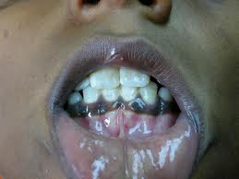
Addison’s Disease
Autoimmune destruction of adrenal gland
How would this anatomically differ from CAH?
Why would blood pressure be low?
Why would there be a risk of hypoglycemia?
Notes:
Hyperpigmentation is due to constant release of ACTH/MSH which are both part of POMC. This is because of reduced negative feedback of Cortisol onto the ACTH releasing cells/

Slide 43
Hyperpigmentation in Addison’s
Hyperpigmentation

Slide 44
Tumors Affecting Adrenal Function
Conn’s syndrome (adenoma of zona glomerulosa)
Cushing’s syndrome
pituitary adenoma (ACTH releasing) or
adenoma of zona fasciculata
Notes:
Talk about how tumors can cause release of extra hormones and why

Slide 45
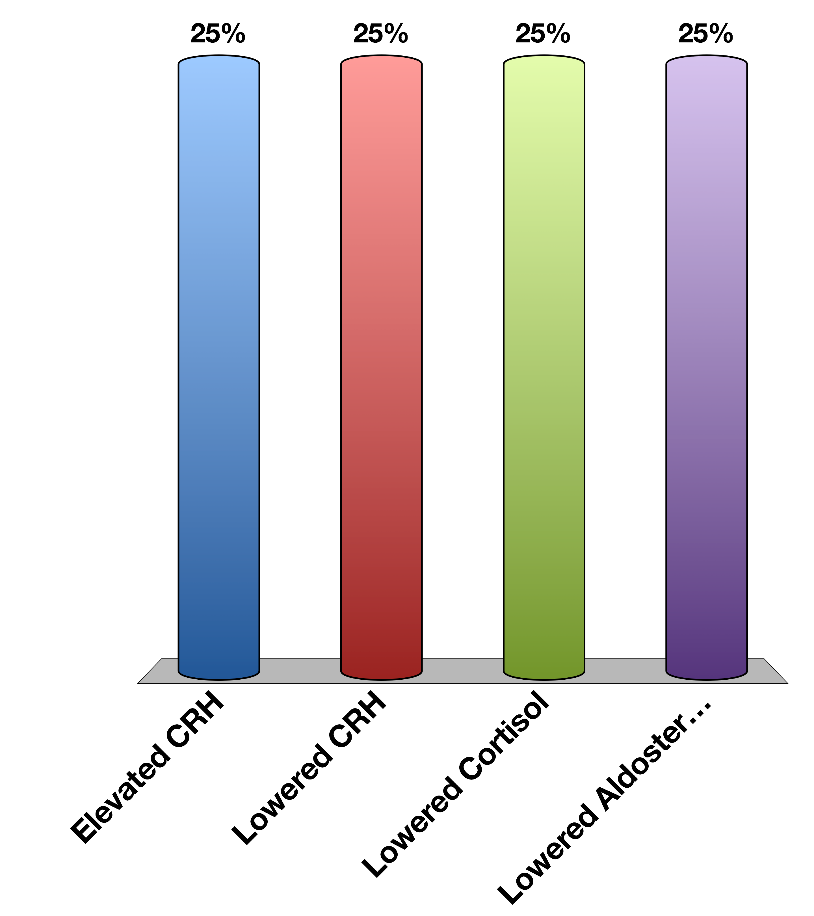
Cushing’s Syndrome (ACTH overproducing tumors) have
Elevated CRH
Lowered CRH
Lowered Cortisol
Lowered Aldosterone
Response Counter
30

Slide 46
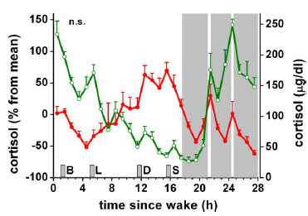
Night Time Workers
Normal
Sleep disrupted
Scheer F AJL, Hilton MF, Mantzoros CS, Shea S A (2009) Adverse metabolic and cardiovascular consequences of circadian misalignment. Proc Natl Acad Sci U S A 106: 4453–4458. doi:10.1073/pnas.0808180106.
Notes:
Fedex workers

Slide 47
Adrenaline Mediates Short-Term Stress Responses

Slide 48
Epinephrine Summary
Where is it made? | Adrenal medulla
What causes its release? | Sympathetic nervous stimulation
What is its receptor? | Alpha/Beta-Adrenergic Receptors (5 subtypes) | GPCR -> Gs and Gi
What tissues does it affect? | Heart | Increased heart rate
 | Lungs | Increased respiration
 | Vasculature | Vasoconstriction (smooth muscle), vasodilation (skeletal muscle)
 | Liver | Glycogenolysis
 | Fat | Lipolysis
 | Skeletal Muscle | Contraction
How does it get turned off? | Sympathetic signal stops

Slide 49
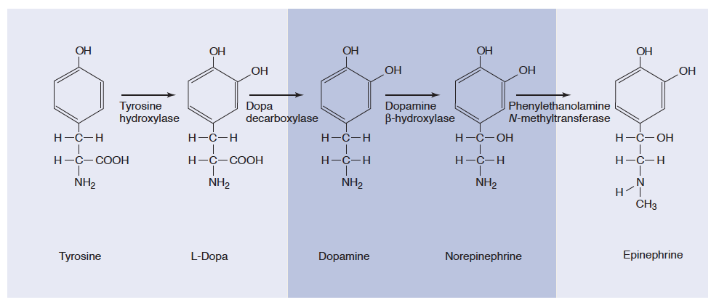
Epinephrine and Norepinephrine
Notes:
Adrenal medulla has high levels of PNMT

Slide 50
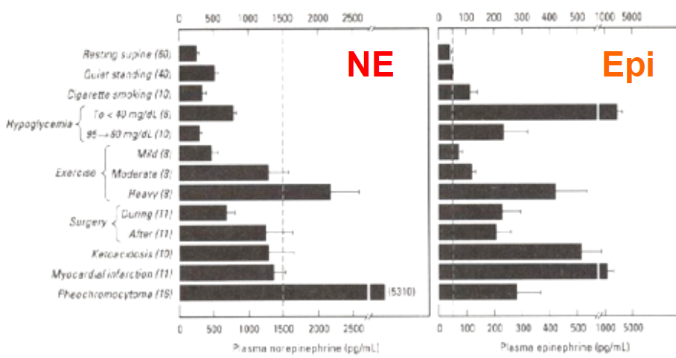
Epinephrine vs Norepinephrine
Dashed line is level in circulation needed to elicit a physiological response

Slide 51
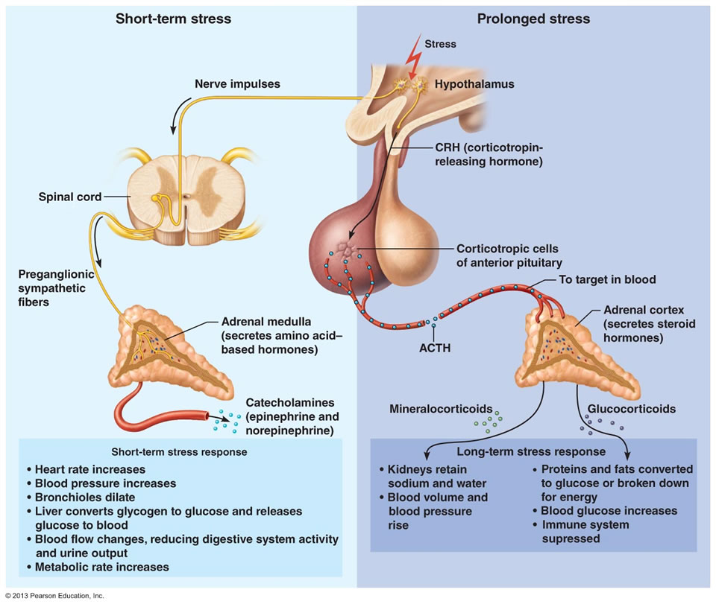
Adrenaline vs Cortisol Release

Slide 52
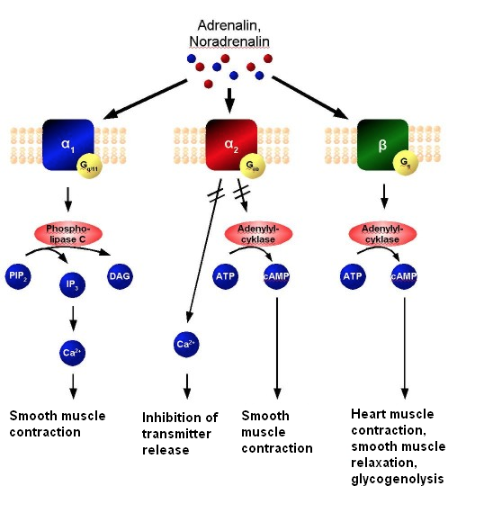
Cardiovascular Roles of Epinephrine
Gq
Gi
Gs
Notes:
Gi/Gq vasoconstriction
Gs vasodilation and heart muscle contraciton

Slide 53
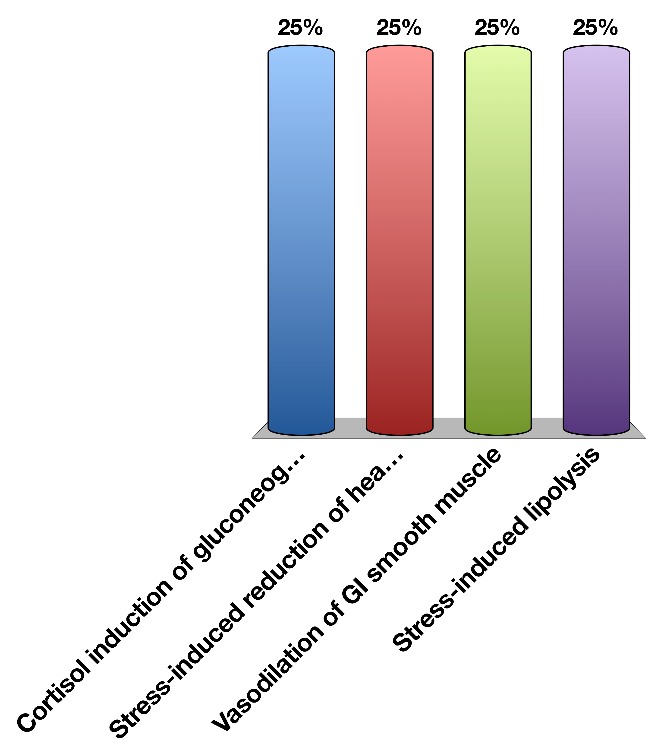
What would a beta blocker affect?
Cortisol induction of gluconeogenesis
Stress-induced reduction of heart rate
Vasodilation of GI smooth muscle
Stress-induced lipolysis
Response Counter
30

Slide 54
Metabolic Roles of Epinephrine

Slide 55
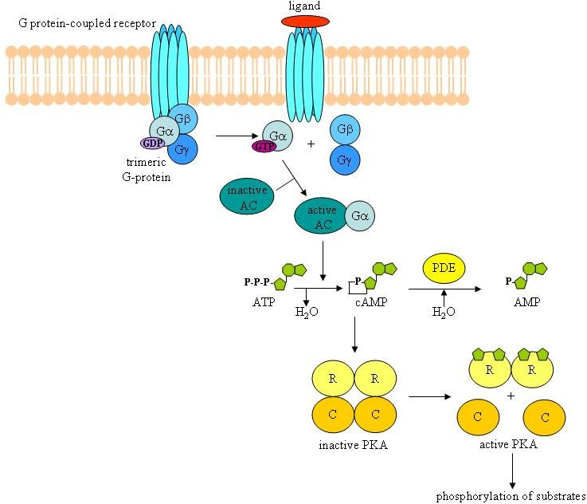
Epinephrine Binds B-AR/Gs in Skeletal Muscle/Liver and Fat Tissue

Slide 56
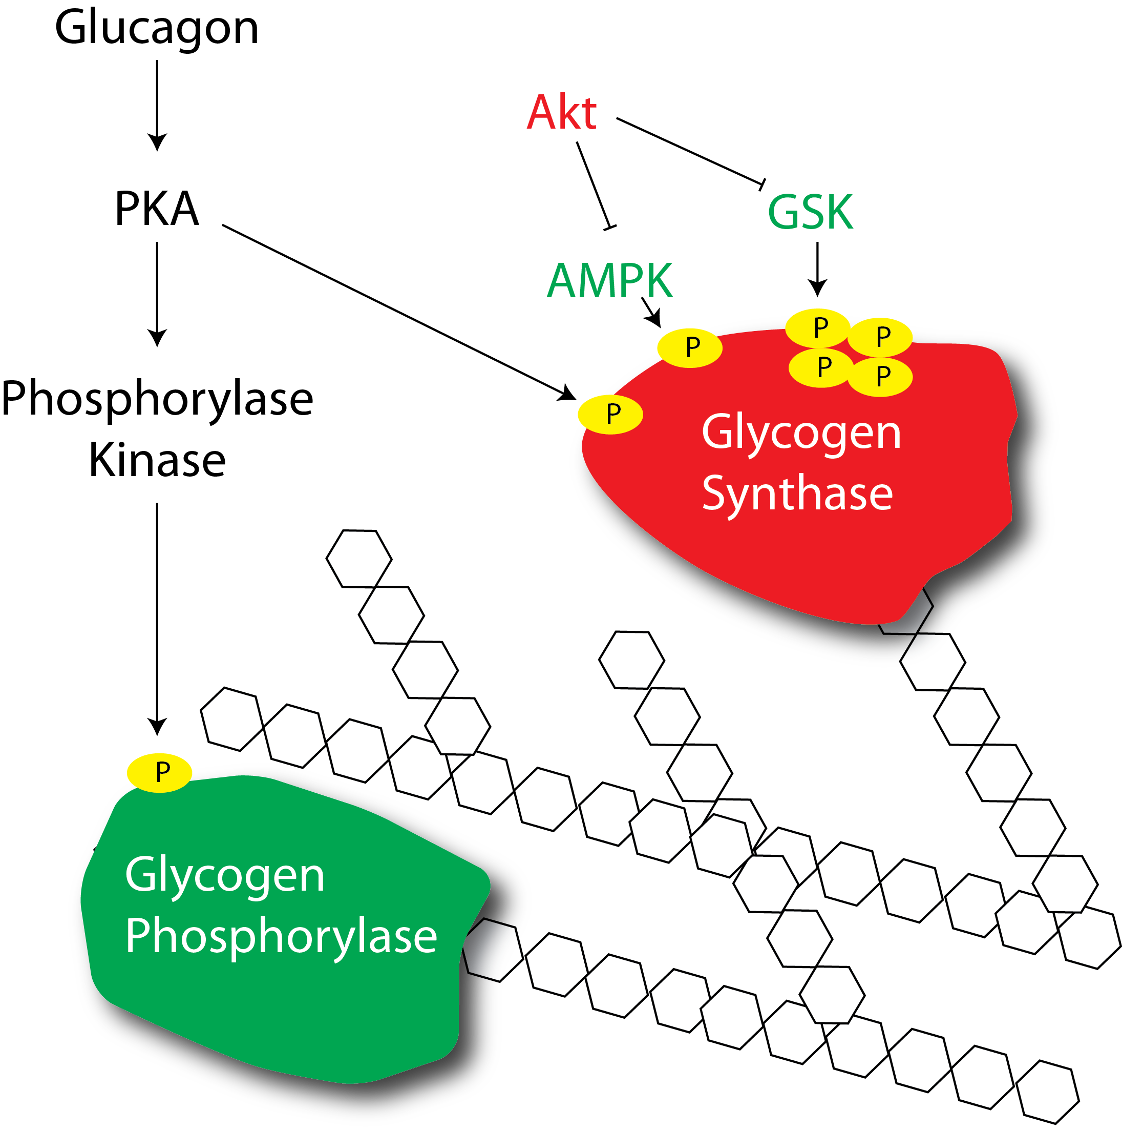
Epinephrine Mediated Activation of Glycogenolysis

Slide 57
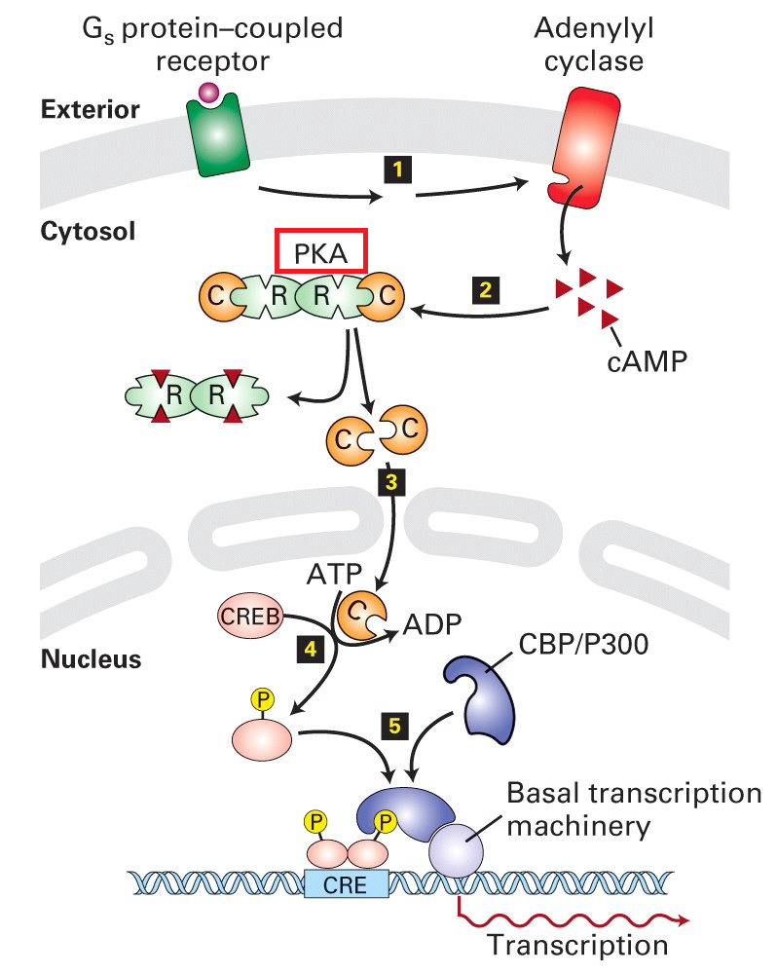
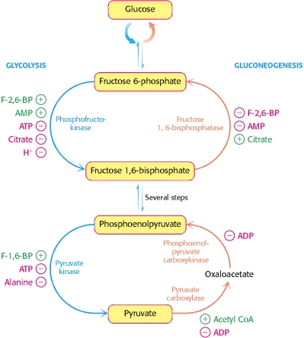
Dual Effects of Epinephrine on Gluconeogenesis in the Liver
PKA
PFK-2
Post-Translational Induction of Gluconeogenesis
Gluconeogenic Gene Transcription

Slide 58
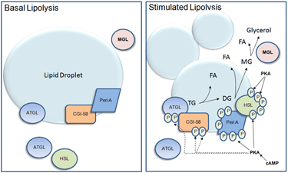
Effects of Epinephrine on Lipid Breakdown

Slide 59

β-AR agonists would be good weight loss drugs except…
They would induce lipid breakdown
They would cause tachycardia
They would cause GI vasodilation
They would prevent gluconeogenesis in the liver
Response Counter
30

Slide 60
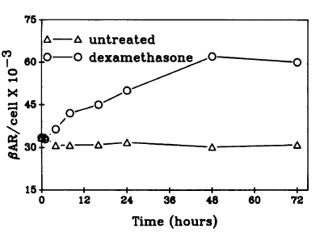
Short Term:Long Term Stress
Chronic Stress
Acute Stress
Cortisol
Epinephrine
Elevated Transcription of
Beta-Adrenergic
Receptors
Glucocorticoid
Receptor
Higher sensitivity
towards epinephrine
Hadcock JR, Malbon CC (1988) Regulation of beta-adrenergic receptors by “permissive” hormones: glucocorticoids increase steady-state levels of receptor mRNA. Proc Natl Acad Sci U S A 85: 8415–8419. doi:10.1073/pnas.85.22.8415.

Slide 61
Pheochromocytoma
Tumor that constitutively secretes adrenaline or noradrenaline
What cardiovascular and molecular phenotypes would this person have?
How could you treat this person?

Slide 62
Learning Objectives
Name three zones in the adrenal cortex and major regulator(s) of each zone.
Name three steroidogenesis pathways and their major products.
Explain briefly the physiological mechanism of adrenogenital syndrome.
Describe the physiological actions and roles of aldosterone.
Explain briefly the renin-angiotensin system.
Describe the negative feedback regulation of aldosterone and its relationship to blood volume/blood pressure homeostasis.
Describe hepatic and extrahepatic metabolic actions of glucocorticoids. Discuss their relationship.
State the major findings caused by adrenal hypersecretion of mineralocorticoids.
State the major findings caused by adrenal hypersecretion of glucocorticoids.
Name the major hormones secreted from the adrenal medulla. Discuss the differences of epinephrine (epi) and norepinephrine (NE) in cardiovascular actions (physiological levels).
List the major metabolic actions of catecholamines.
Contrast the thresholds for actions vs. plasma levels of epi and NE under common conditions, like exercise, and in the disease pheochromocytoma

Slide 63
Endocrine Control of Growth

Slide 64
Learning Objectives
List the hormones important for growth at key times in a person's life.
Describe the functions of human growth hormone on growth (bones and soft tissues), and on metabolism, and the regulation of its secretion. Explain what 'rhGH' means.
State the "dual effector hypothesis" for GH actions, and the relative roles of GH and IGF-1 in growth control.
Describe the interactions among all the key growth-regulating hormones at key times of a person's life: in utero, neonatally, childhood, puberty, adulthood, and senescence.
Describe the daily regulation of GH levels and the physiological relevance of these cycles.

Slide 65
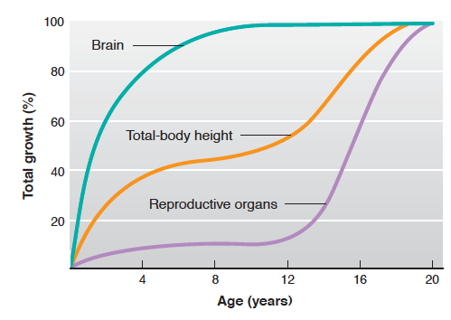
Human Organ Growth

Slide 66
Hormones During Growth
Stage | Age | Hormonal Requirements
Prenatal | (9 months) | Insulin
Infantile | 0-1 | Insulin
Juvenile | 1-12 years | GH, Insulin, T3, Vitamin D
Adolescent (Pubertal) | 10-14 (F) 12-16 (M) | GH, insulin, T3, Vitamin D and Sex Steroids
Adult | Puberty – 100 | Normally limited growth

Slide 67
Growth Hormone Summary
What chemical type is it? | Protein
Where is it made? | Somatotropes of Anterior Pituitary
What causes its release? | GHRH release (also regulated by somatostatin)
What is its receptor? | Growth Hormone Receptor | JAK/STAT
What tissues does it affect? | Liver | IGF-1 Release
 | Bones | Growth
 | Muscle | Protein Synthesis
 | Adipose Tissue | Lipolysis
How does it get turned off? | IGF Negative Feedback to Pituitary and Hypothalamus. GH/IGF1 Stimulation of somatostatin and receptor desensitization

Slide 68
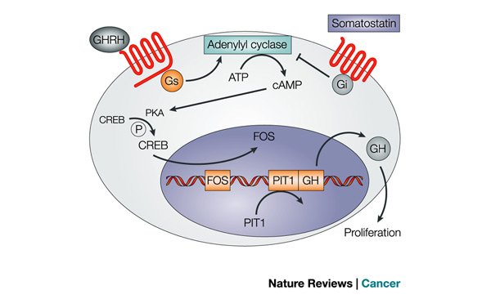
Regulation of GH Release

Slide 69
GH Goes Down with Aging
Think of some possible mechanisms by which this could happen?
Less GH synthesis
Less GHRH responsiveness
Less GHRH synthesis
More SST synthesis
More SST responsiveness
Notes:
Less GH synthesis
Less GHRH responsiveness
Less GHRH synthesis
More SST synthesis
More SST responsiveness

Slide 70
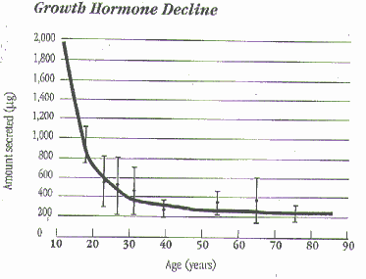
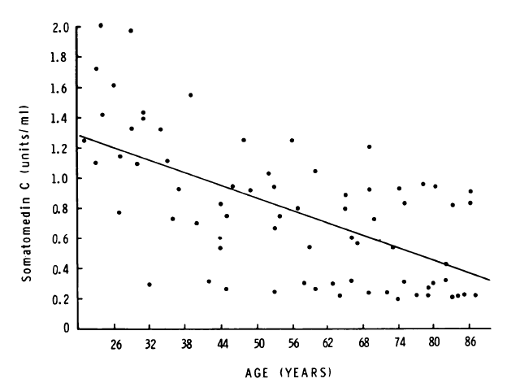
GH and Aging
GHRH Levels
Rudman D, Kutner MH, Rogers CM, Lubin MF, Fleming G a., et al. (1981) Impaired growth hormone secretion in the adult population. Relation to age and adiposity. J Clin Invest 67: 1361–1369. doi:10.1172/JCI110164.

Slide 71
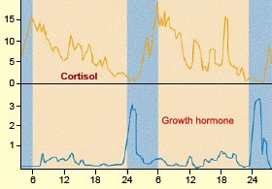
Diurnal Rhythms of GH Release
Notes:
Discuss advantages of GH peaking at night

Slide 72
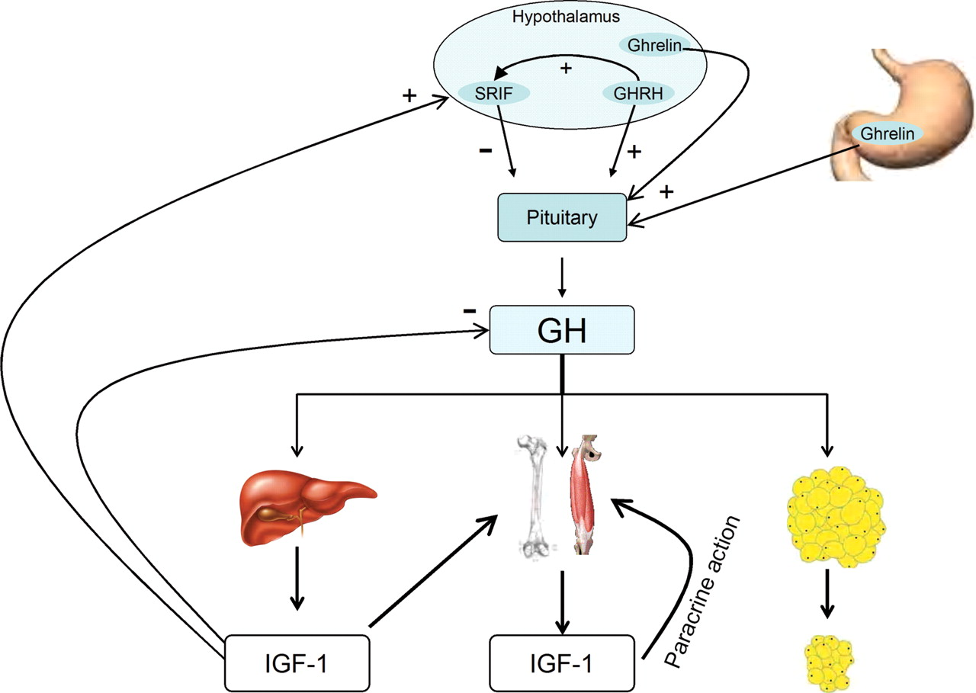
Growth Hormone Causes IGF-1 Release

Slide 73
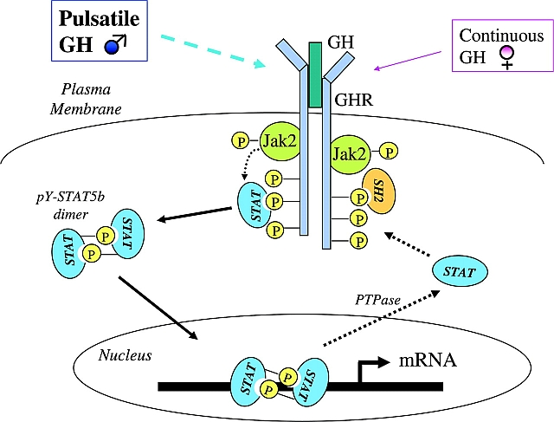
Growth Hormone Receptor

Slide 74
IGF-1 Summary
What chemical type is it? | Protein
Where is it made? | Liver
What causes its release? | GH Signaling
What is its receptor? | IGF1R | Receptor Tyrosine Kinase
What tissues does it affect? | Liver | IGF-1 Release
 | Bones | Chondrocyte replication
 | Muscle | Protein Synthesis
How does it get turned off? | Receptor desensitization, Less GH production, IGF-1 degradation

Slide 75
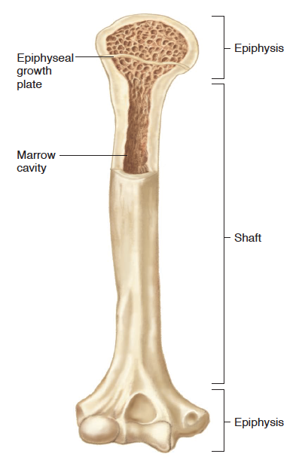
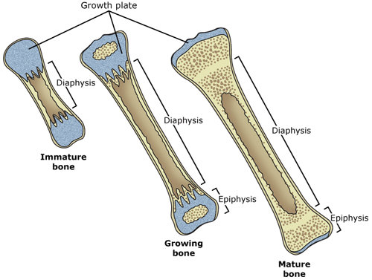
Regulation of Bone Growth

Slide 76
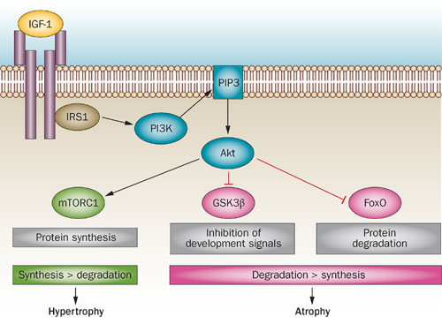
Regulation of Muscle Growth

Slide 77
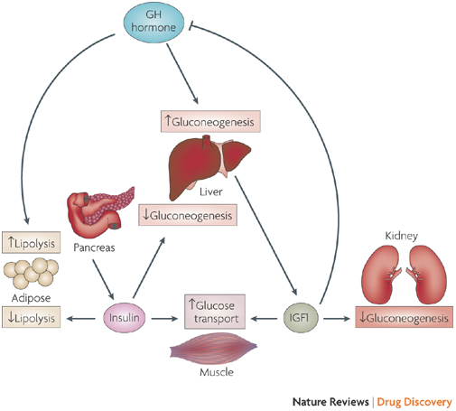
Effects of GH/IGF1 on Metabolism
Notes:
Dual efffector hypothesis

Slide 78
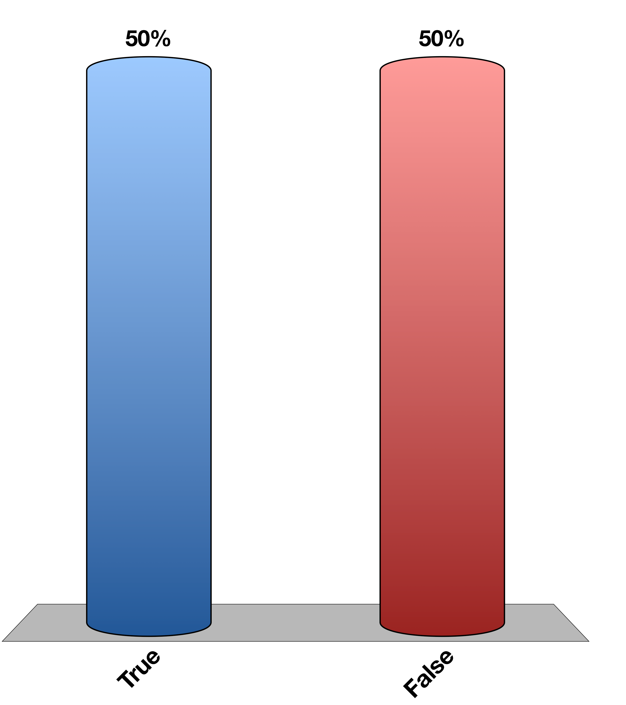
Can you recapitulate all the effects of GH by Providing IGF-1
True
False
Response Counter
15
Notes:
Dual-effector hypothesis

Slide 79
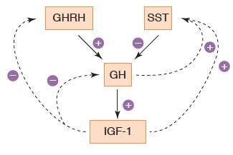
Negative Feedback of GH

Slide 80

Other Hormones Influencing GH

Slide 81

T3, Cortisol and GH Synthesis
Yaffes BM, Samuels HH (1984) Hormonal Regulation of the Growth Hormone Gene. J Biol Chem 259: 6284–6291.

Slide 82

Acromegaly
Pituitary tumor of the somatotropes
Overproduction of GH
Clinical presentation
Bone growth
Protruding brow and jaw, spacing of teeth
Low body fat increased muscle
Insulin resistant/diabetic

Slide 83
Dwarfism/Growth Hormone Deficiency
Congenital or immune destruction of somatotropes
Can be GH deficiency or GH resistance
Can be secondary to hypothyroidism
Clinical features
Reduced height
Reduced muscle mass
Elevations in fat mass
Resistance to diabetes
Notes:
70% of cases are In the context of achondroplasia, this mutation causes FGFR3 to become constitutively active, inhibiting bone growth

Slide 84
Learning Objectives
List the hormones important for growth at key times in a person's life.
Describe the functions of human growth hormone on growth (bones and soft tissues), and on metabolism, and the regulation of its secretion. Explain what 'rhGH' means.
State the "dual effector hypothesis" for GH actions, and the relative roles of GH and IGF-1 in growth control.
Describe the interactions among all the key growth-regulating hormones at key times of a person's life: in utero, neonatally, childhood, puberty, adulthood, and senescence.
Describe the daily regulation of GH levels and the physiological relevance of these cycles.

